Slide 1
10.009 Digital World
Week 9
Man, Geoksee

Slide 2
Topic: State Machine
State machine
Programming state machine in Python
Cohort 2 / 3: Lab: BoundaryFollower, using state machine and robot
Read DW notes Chapter 4.1 (eDimension)!!!

Slide 3

State Machine
A mathematical model of computation system
On the step, the system
gets input
generates output and
moves to a new state
Output and next state depend on input and current state
Explicit representation of stepwise nature of required computation.
We focus on discrete time system: inputs and outputs are determined at specific step / increments of time

Slide 4
State Machine
Specify a state machine by:
  A set of states S
  A set of inputs, I (input vocabulary / input symbol)
  A set of outputs, O
  A next-state function, n(s_{n}, i_{n}) = s_{n+1}, that maps the input at step n and state at step n to the state at step n+1
  An output function, o(s_{n}, i_{n}) = o_{n}, that maps the input at step n and state at step n to the output at step n
  An initial state, s₀

Slide 5
State Machine Example: Accumulator
Output is the sum of all the inputs it has even seen
[100, -3, 4, …]
[100, 97, 101, …]
S= Number
I = Number
O = Number
n(s,i) = s+i
o(s,i) = s+i
s₀=0

Slide 6
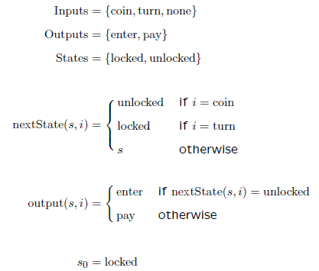
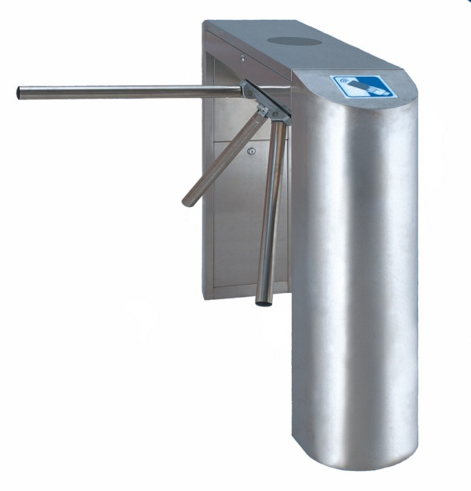
State Machine Example: Turnstile
- If it is locked and someone puts in a coin, then it becomes unlocked, and turns on a sign ‘enter’.
- If it is unlocked and someone turns the turnstile, then it becomes locked and the sign becomes ‘pay’

Slide 7
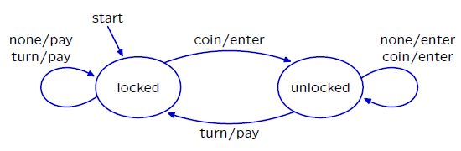
State Transition Diagram
Graphical representation of process.
Nodes represent states
Arcs represent transitions: label is input / output

Slide 8
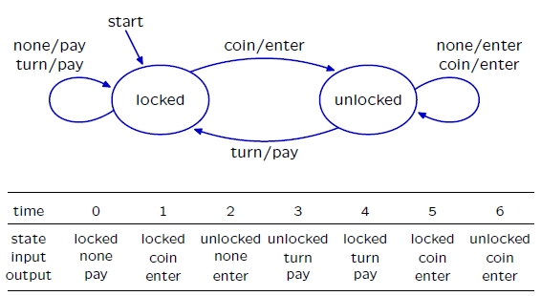
Transition Table

Slide 9
Programming state machine in Python
Use inheritance to inherit code from superclass SM
Specify the state machine:
  Specify the initial state (startState: class attribute vs. instance attribute)
  Specify the nextstate function and output function in instance method getNextValues
Done, have created a new class of state machine, use with
  start + step
  transduce

Slide 10
Example: Accumulator
import libdw.sm as sm # need this for superclass SM
class Accumulator(sm.SM): #like syntax: math.sin math.pi
startState=0 #class attribute, i.e., same for all instances
def getNextValues(self, state, inp): # current state, input
nextState=state+inp # n(s,i)
outp = state+inp # o(s,i)
return nextState, outp
Note that getNextValues should not change self.state
Other instance method will call getNextValues to get the state and assign to self.state

Slide 11
Example: Accumulator
>>> a = Accumulator()
>>> a.start()
>>> a.step(100)
100
>>> a.step(-3)
97
>>> a.state
97
>>> a.step(4)
101
>>> b = Accumulator()
>>> b.transduce([100,-3,4])
[100, 97, 101]
>>>

Slide 12
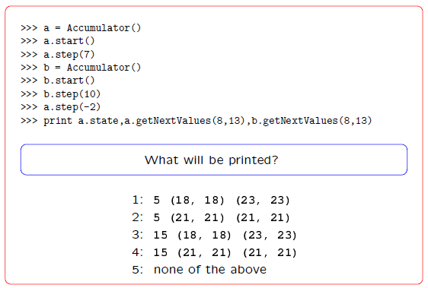
Question

Slide 13
Different startState for different instance: use __init__
import libdw.sm as sm # need this for superclass SM
class Accumulator(sm.SM):
def __init__(self, initValue):
self.startState = initValue
def getNextValues(self, state, inp):
nextState = state + inp
outp = state + inp
return nextState, outp
>>> a = Accumulator(100)
>>> a.transduce([100,97, 101])
[200, 297, 398]
>>>

Slide 14
Another Python SM example: Turnstile
class Turnstile(sm.SM):
startState = 'locked'
def getNextValues(self, state, inp):
if state == 'locked':
if inp == 'coin':
nextState, outp = 'unlocked', 'enter'
elif inp == 'turn':
nextState, outp = 'locked', 'pay'
else: #inp == None
nextState, outp = 'locked', 'pay'
else: # state == 'unlocked'
if inp == 'coin':
nextState, outp = 'unlocked', 'enter'
elif inp == 'turn':
nextState, outp = 'locked', 'pay'
else: #inp == None
nextState, outp = 'unlocked', 'enter'
return nextState, outp

Slide 15
Another Python SM example: Turnstile
>>> ts = Turnstile()
>>> testInput = [None, 'coin', None, 'turn', 'turn', 'coin', 'coin']
>>> ts.transduce(testInput)
['pay', 'enter', 'enter', 'pay', 'pay', 'enter', 'enter']
>>>

Slide 16
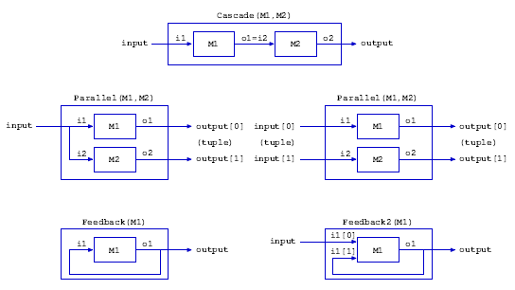
State Machine Combinators
State machines can be combined for more complicated tasks.
Notes:
First five cohort exercises before 2nd cohort session.

Slide 17
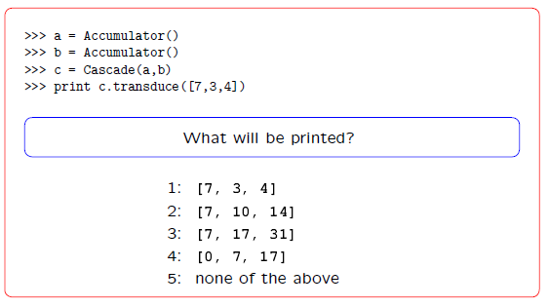
Question

Slide 18
SM Class
The generic methods of the SM class use startState to initialize the instance variable state. Then getNextValues is used to process inputs, so that step can update state
class SM:
def start(self):
self.state = self.startState
def step(self, inp):
(s, o) = self.getNextValues(self.state, inp)
self.state = s
return o
def transduce(self, inputs):
self.start()
return [self.step(inp) for inp in inputs]
Note that getNextValues should not change state
The state is managed by start and step

Slide 19
Reference for SM / libdw
What other methods can be used in subclass of SM?
Other available subclass of SM (in addition to Cascade)?
http://people.sutd.edu.sg/~stanleykok/digiworld/html/index.html

